Slide 1

Introductory to Machine Learning with R – Day 3
Presented by Priscila Grecov
Monash University CRICOS Provider Number: 00008C

Slide 2

Full Program
Day 1
Elements and key concepts of Machine Learning
Prediction vs Inference / Supervised vs Unsupervised Learning / Regression, Classification, Clustering
ML Process / Parameter learning: training, validation and testing sets
Learning a model / Overfitting vs Underfitting
Regression Analysis: Linear Models for Regression (Supervised Learning)
Day 2
Classification Analysis and Models (Supervised Learning)
KNN
Logistic Regression (for classification and regression problems)
Decision Trees (for classification and regression problems)
Random Forest
Day 3
Clustering Analysis and Models (Unsupervised Learning)
K-mean clustering (partitional clustering)
Dimensionality reduction - PCA
Perceptron Learning Algorithm, an introduction to neural networks
Schedule hours for each day:
9 am – 4 pm
1st break – 15” --> 10:30 to 10:45 am.
2nd break – 1h --> 12 pm to 1 pm.
3rd break – 15” --> 2:30 pm to 2:45 pm.

Slide 3

Zoom of Day 3
DAY 3
Clustering Models (Unsupervised Learning) – general view
K-Means
Theory
Practice
PCA - Dimensionality reduction
Theory
Practice
Neural Networks – light introduction
Basic Concepts
Demonstration
Schedule hours for each day:
9 am – 4 pm
1st break – 15” --> 10:30 to 10:45 am.
2nd break – 1h --> 12 pm to 1 pm.
3rd break – 15” --> 2:30 pm to 2:45 pm.

Slide 4

Just reviewing…
Unsupervised learning
Cluster analysis
Association analysis
Supervised learning
Classification
Regression
Notes:
Focus of next lecture, for now we will be looking at hierarchical clustering

Slide 5
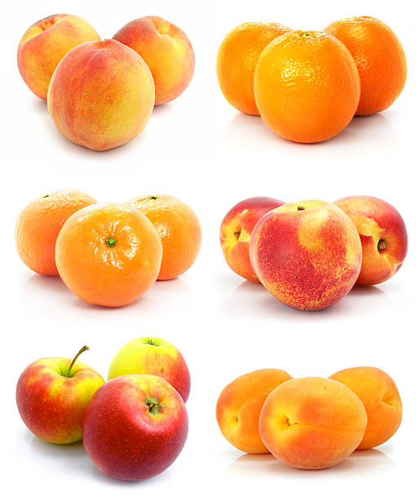
What is Cluster Analysis
Cluster: collection of data objects
Grouping similar objects in a cluster
No pre-defined classes → unsupervised classification
For analysis of data
Cluster analysis – grouping a set of data objects into cluster
In what contexts would you want to complete a cluster analysis?
Notes:
Reference for picture in case you need it: https://www.google.com/search?biw=1280&bih=617&tbm=isch&sa=1&ei=qCMTXPO5PM2FyAOW9Bw&q=apples+and+oranges+cluster+group&oq=apples+and+oranges+cluster+group&gs_l=img.3...33551.35624..35823...2.0..1.396.1847.2-3j3......1....1..gws-wiz-img.zjt7EzL45bE#imgrc=ASclS4XU_jBeiM:

Slide 6
Cluster Analysis Applications
Market segmentation – targeted marketing
Market structure analysis – identify groups of similar products according to competitive measures of similarity
Finance – develop a balanced portfolio
eg. Volatility, beta, vega, returns over different periods
Land use – identify are of similar land use in Earth observation database
Medical
eg. Types of tumour

Slide 7
Clustering Methods
Clustering
Hierarchical clustering
K-means
Partitional clustering
Devisive
Agglomerative

Slide 8
Clustering Methods
Partitional clustering
K-Means
Random assignment of points in the midst of cluster
Repeatedly re-assign points cluster
Minimise within-cluster distances
Maximise between-cluster distances
8
Notes:
Focus of next lecture, for now we will be looking at hierarchical clustering

Slide 9
Clustering Algorithms
Hierarchical clustering | K-means clustering
Suitable for small data set (<500 observations) Easily examine solutions with increasing numbers of clusters Convenient method if you want to observe how clusters are nested | Suitable if you know how many clusters you want Large data set Good for summarising data with k “average” observations that describe the data with the minimum amount of error
Notes:
Focus of next lecture, for now we will be looking at hierarchical clustering

Slide 10
Obtaining clusters: K means method
Non-hierarchical clustering method
Require number of clusters be specified before assigning observations
No single objective method for determining the number of clusters

Slide 11
K-Means Clustering
Given the value of K, the K-means algorithm randomly partitions the observations into K clusters
After all observations have been assigned to a cluster, the resulting cluster centroids are calculated
Using the updated cluster centroids, all observations are reassigned to the cluster with the closest centroid (usually Euclidean distance)
Continue until the assignments no longer change or a predetermined maximum number of iterations is reached

Slide 12
K-Means Clustering
Number of K clusters needs to be specified, usually advisable to try several values of K
Initial K clusters are chosen randomly and the results do depend strongly on this particular starting point – procedure should be repeated a number of times (>10) with different starting points
The “best” result is chosen
Notes:
The algorithm repeats this process (calculate cluster centroid, assign observation to cluster with nearest centroid) until there is no change in the clusters or a specified maximum number of iterations is reached.
One rule of thumb is that the ratio of between-cluster distance to within-cluster distance should exceed 1.0 for useful clusters.

Slide 13
Recall: Centroid
A centroid is the average observation of a cluster
The average value for each variable across the observations in the cluster
Centroid does not have to be an actual observation
7
4
3
1
2
5
8
6

Slide 14
K-means clustering
Algorithm K-means
Decide on a value for K.
Initialize the K cluster centers (randomly, if necessary).
Decide the class memberships of the N objects by assigning them to the nearest cluster center
Re-estimate the K cluster centers, by assuming the memberships found above are correct.
If none of the N objects changed membership in the last iteration, exit. Otherwise go to 3.

Slide 15
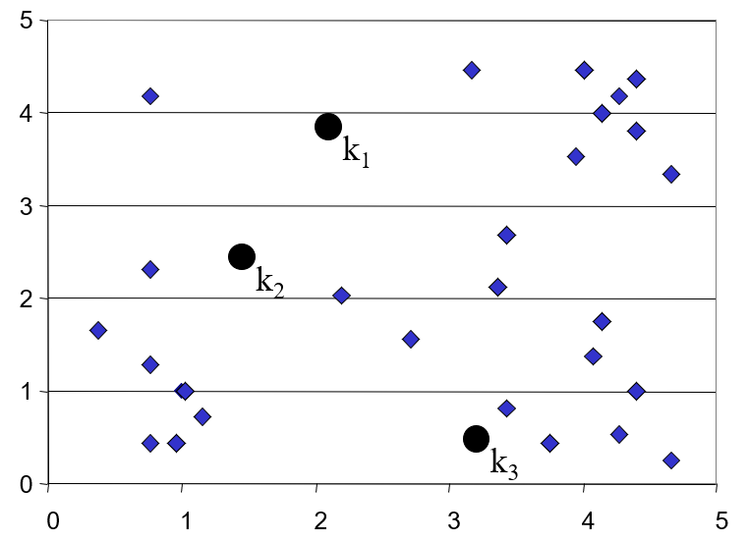
K-means Clustering: Step 1
Algorithm: k-means, Distance Metric: Euclidean Distance
Notes:
Step 1: define the k’s

Slide 16
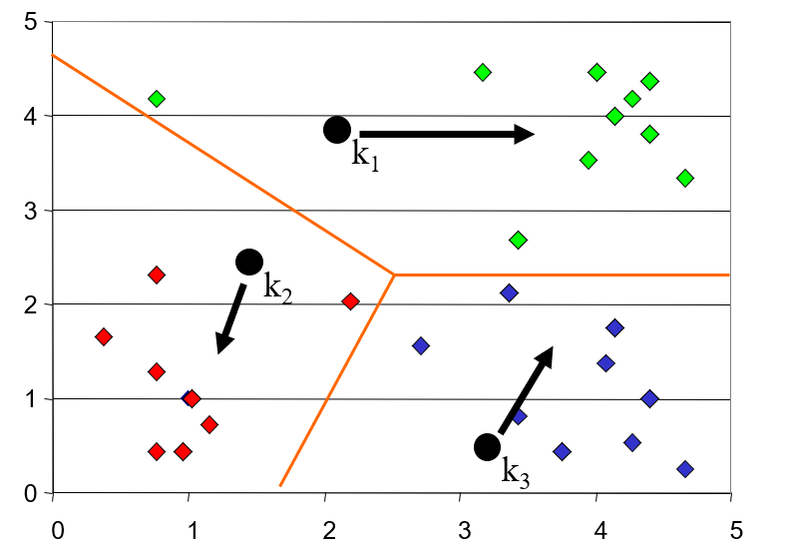
K-means Clustering: Step 2
Algorithm: k-means, Distance Metric: Euclidean Distance
Notes:
Step 2: divide in groups as were defined the k’s

Slide 17
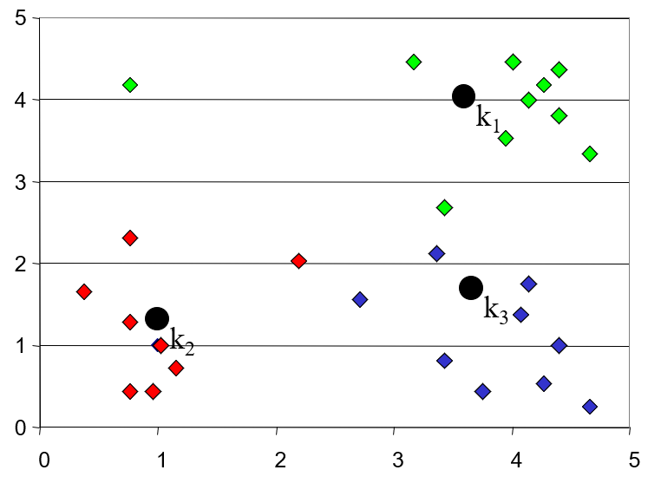
K-means Clustering: Step 3
Algorithm: k-means, Distance Metric: Euclidean Distance
Notes:
Step 3: redefines the k-values minimizing the distances of k(i) from points of its cluster

Slide 18
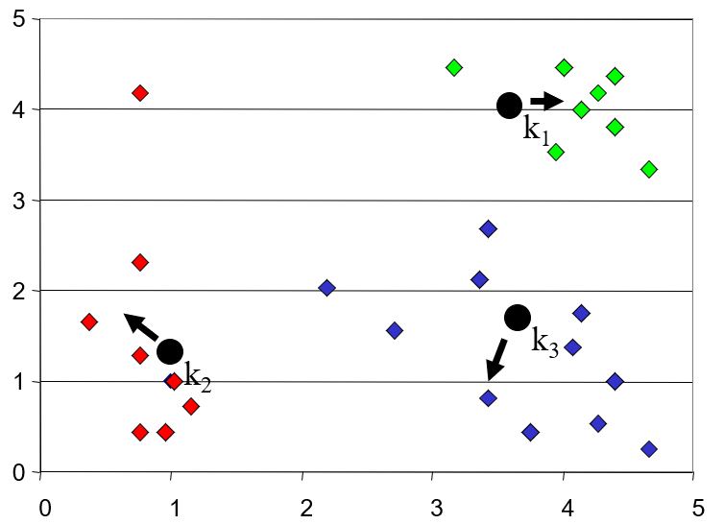
K-means Clustering: Step 4
Algorithm: k-means, Distance Metric: Euclidean Distance
Notes:
Step 4: redefine the clusters

Slide 19
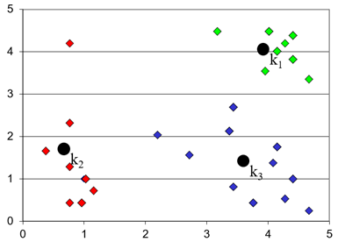
K-means Clustering: Step 5
Algorithm: k-means, Distance Metric: Euclidean Distance
Notes:
Steps summary: see photo

Slide 20
Within Sum of Squares
Use to represent Euclidean distance in n dimensional space, where n is the number of variables
Suppose we have k clusters, call them
We are trying to select the clusters in such a way as to minimise the “within sum of squares”
Where are the members of the clusters, and is the centroid of cluster j
Notes:
The algorithm repeats this process (calculate cluster centroid, assign observation to cluster with nearest centroid) until there is no change in the clusters or a specified maximum number of iterations is reached.
One rule of thumb is that the ratio of between-cluster distance to within-cluster distance should exceed 1.0 for useful clusters.

Slide 21
Total_SS and Between_SS
Total_SS = sum of squared distances of each data point to the global sample mean
Obtain between_SS:
For each cluster, calculate the squared distance from the centroid of the cluster to the global sample mean
Multiply by the number of points in the cluster
Add up the results for each cluster
If there were no discernible pattern of clustering, the 3 means of the 3 groups would be close to the global mean, and between_SS would be a very small fraction of total_SS
Notes:
The algorithm repeats this process (calculate cluster centroid, assign observation to cluster with nearest centroid) until there is no change in the clusters or a specified maximum number of iterations is reached.
One rule of thumb is that the ratio of between-cluster distance to within-cluster distance should exceed 1.0 for useful clusters.

Slide 22
Outcome Measure
Since we want little variation within clusters and a lot of variation between clusters
The ratio betweenss/totss is a possible measure of how good the clustering is that K means has found
Notes:
The algorithm repeats this process (calculate cluster centroid, assign observation to cluster with nearest centroid) until there is no change in the clusters or a specified maximum number of iterations is reached.
One rule of thumb is that the ratio of between-cluster distance to within-cluster distance should exceed 1.0 for useful clusters.

Slide 23
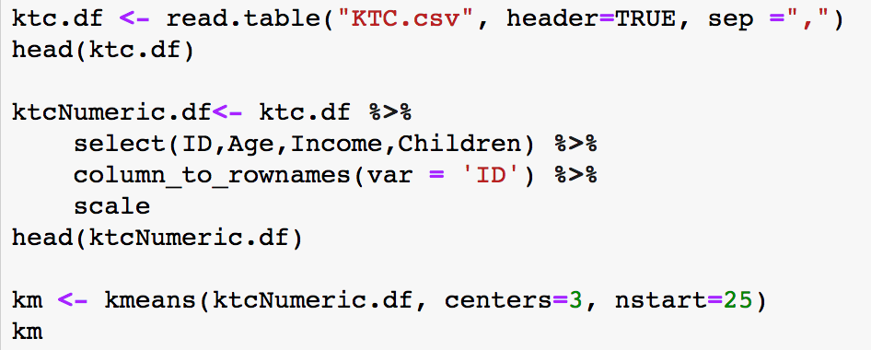
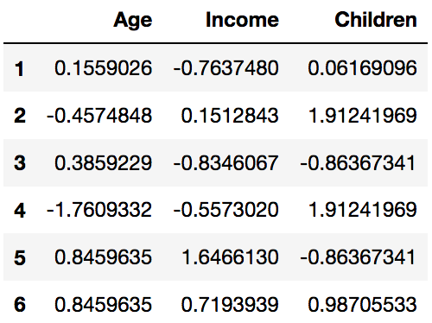
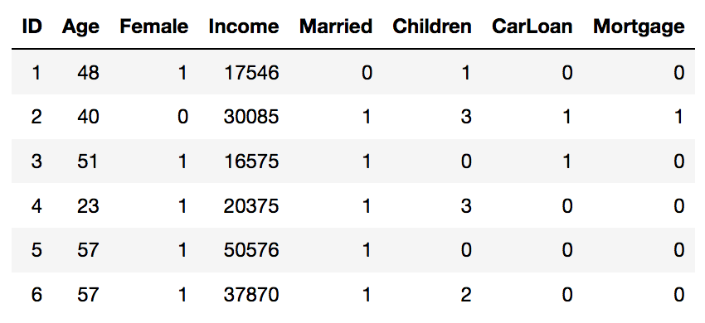
Example: Step by Step

Slide 24
KTC Using K-Means
Centres is the value of K, that is the number of clusters
nstart is the number of times you run through the procedure
A recommended value is 25
Notes:
Stop here until tutorial part done.

Slide 25
KTC Using K-Means
Centres is the value of K, that is the number of clusters
nstart is the number of times you run through the procedure
A recommended value is 25
Notes:
Stop here until tutorial part done.

Slide 26
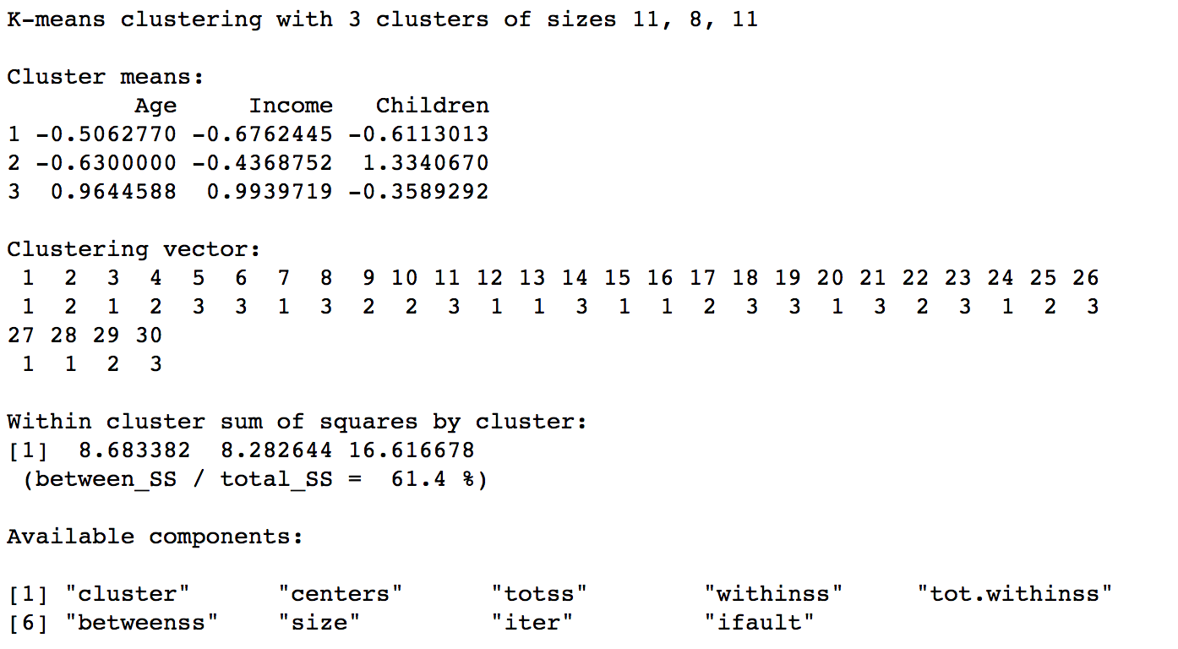
K-Means Output

Slide 27
What are the Pros and Cons of k-Means?
Pros
Simple and fast for low dimensional data (time complexity of K Means is linear i.e. O(n))
Scales to large data sets
Easily adapts to new data points
• Cons
• It does not work well with clusters (in the original data) of different size and different density
• It will not identify outliers
Restricted to data which has the notion of a center (centroid)
Notes:
- K-means is the fastest method of clustering

Slide 28
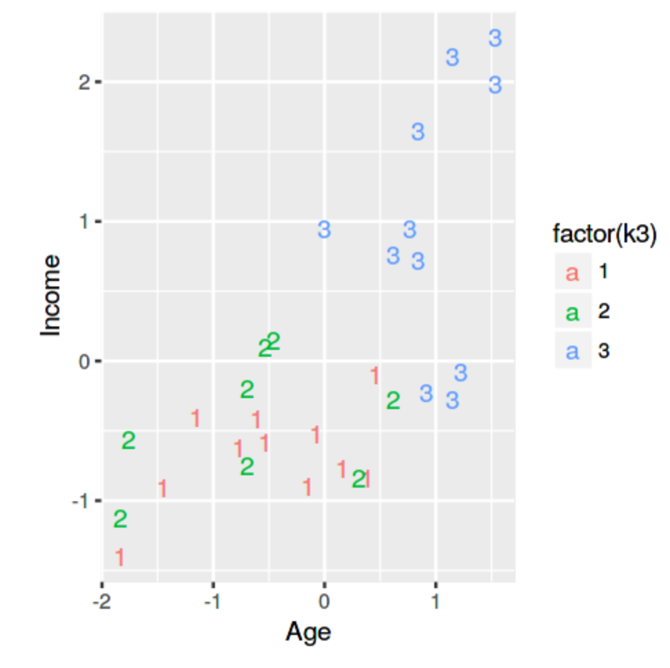
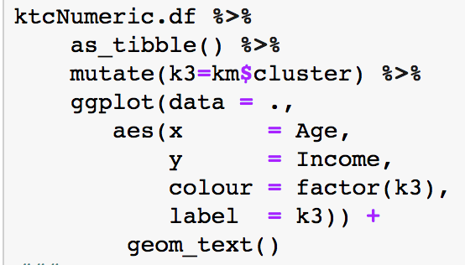
2-Dimension Graph
Notes:
Cluster 1 is characterized by relatively younger, lower-income customers
Cluster 2 is characterized by relatively older, higher-income customers
Cluster 3 is characterized by relatively older, high-income customers
Cluster 1 and 2 seem to be very similar -> not a great seperation
| k3 | Age | Female | Income | Married | Children | CarLoan | Mortgage |
|----|----------|-----------|----------|-----------|-----------|-----------|-----------|
| 1 | 39.36364 | 0.6363636 | 18745.09 | 0.6363636 | 0.2727273 | 0.4545455 | 0.5454545 |
| 2 | 58.54545 | 0.5454545 | 41632.64 | 1.0000000 | 0.5454545 | 0.2727273 | 0.2727273 |
| 3 | 37.75000 | 0.5000000 | 22025.25 | 0.7500000 | 2.3750000 | 0.6250000 | 0.3750000 |

Slide 29
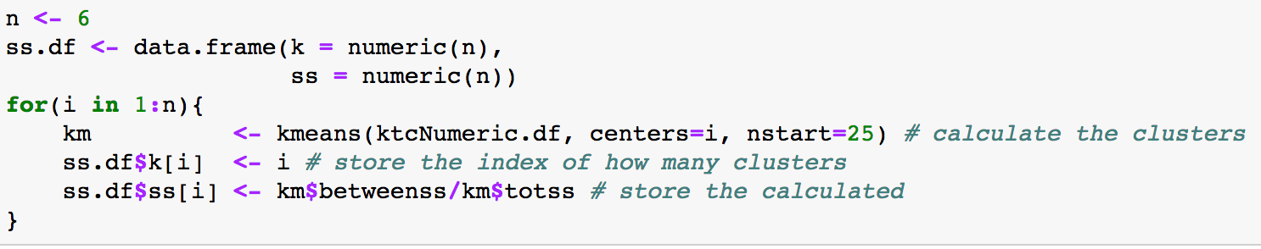
Choosing K
The choice of k needs to be varied. Rather than trying out possible values, write code to do this:
29
Notes:
Use Elle`s hat example for person for the loop

Slide 30
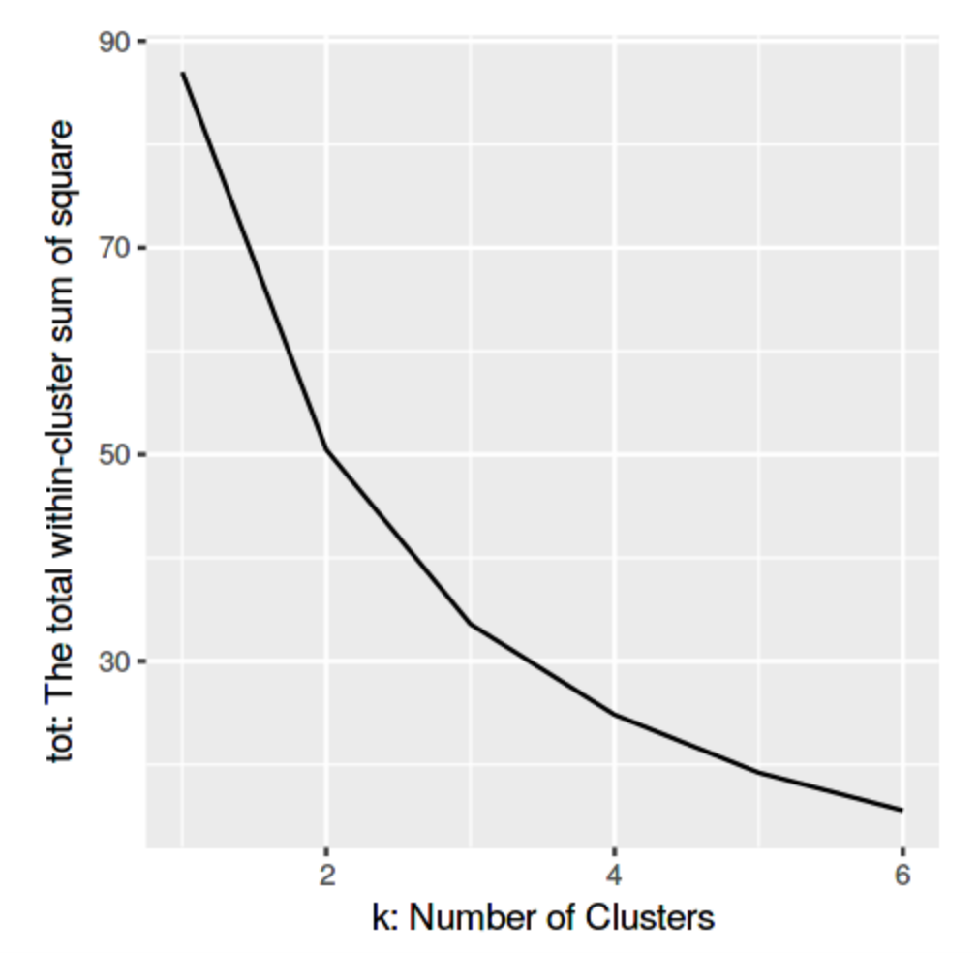
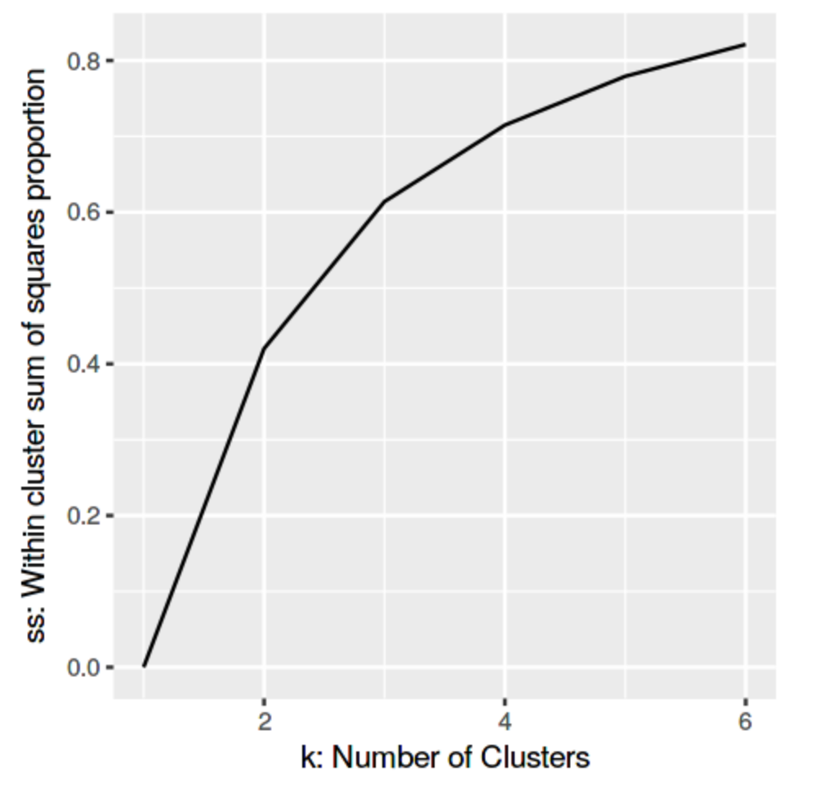
Plot of Within Cluster Sum of Squares
The total within-cluster sum of square measures the compactness (i.e goodness) of the clustering and we want it to be as small as possible

Slide 31
Summary
Cluster analysis is an exploratory tool. Useful only when it produces meaningful clusters
Hierarchical clustering gives visual representation of different levels of clustering
On other hand, due to non-iterative nature, it can be unstable, can vary highly depending on settings, and is computationally expensive
Non-hierarchical is computationally cheap and more stable; requires user to set k
Be wary of chance results; data may not have definitive “real” clusters

Slide 32

Let’s practice!

Slide 33
Principal Components Analysis - PCA
Goal: Reduce a set of numerical variables.
The idea: Remove the overlap of information between these variable. [“Information” is measured by the sum of the variances of the variables.]
Final product: A smaller number of numerical variables that contain most of the information

Slide 34
Principal Components Analysis - PCA
How does PCA do this?
Create new variables that are linear combinations of the original variables (i.e., they are weighted averages of the original variables).
These linear combinations are uncorrelated (no information overlap), and only a few of them contain most of the original information.
The new variables are called principal components.

Slide 35
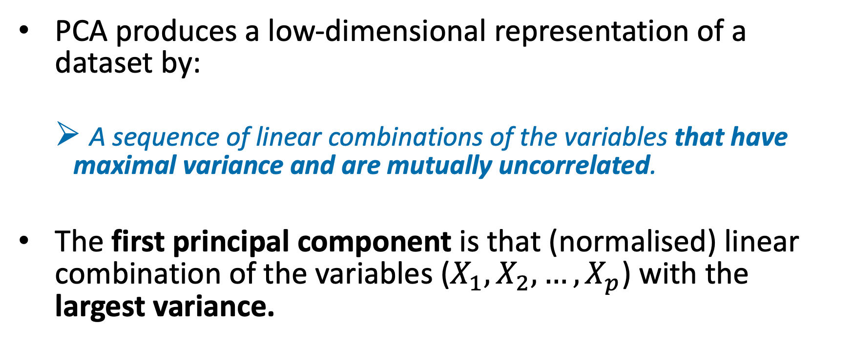
Principal Components Analysis - PCA
PCA produces a low-dimensional representation of a dataset by:
A sequence of linear combinations of the variables that have maximal variance and are mutually uncorrelated.
The first principal component is that (normalised) linear combination of the variables ($X_{1},X_{2},…,X_{p}$) with the largest variance.

Slide 36
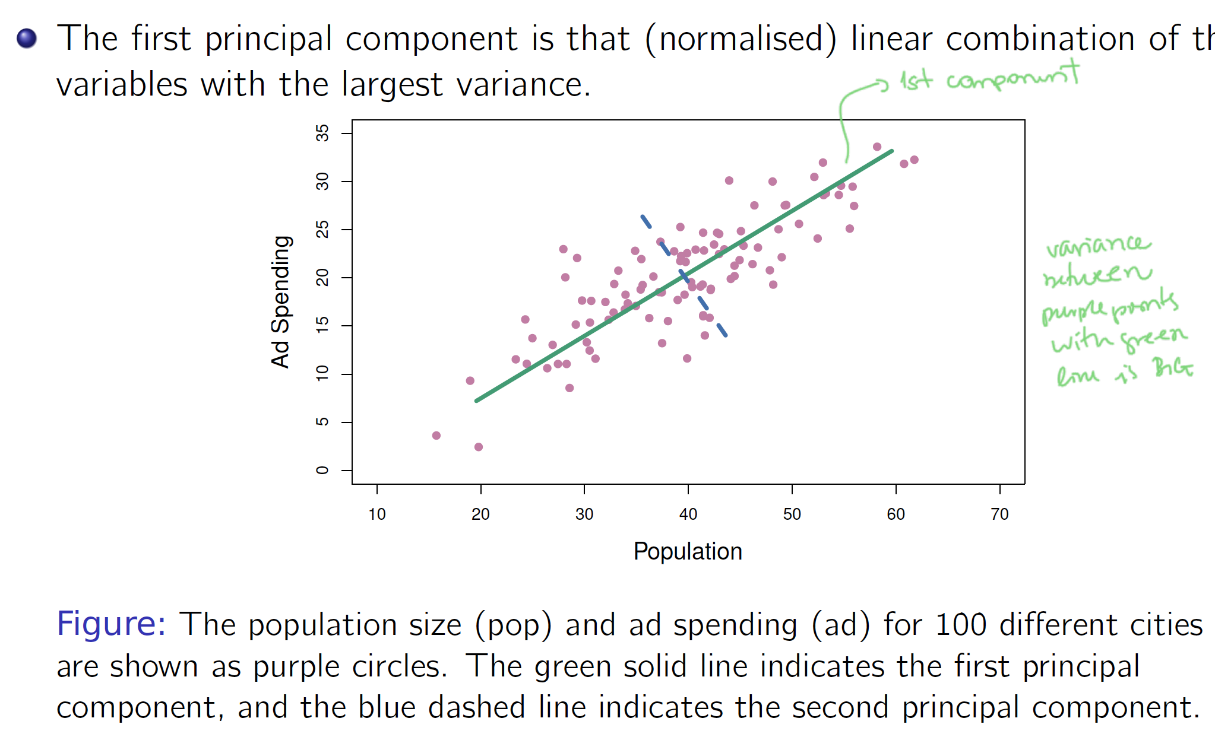
PCA: Visualise First Principle Component
1st component
Variance between purple points are green line are the largest

Slide 37
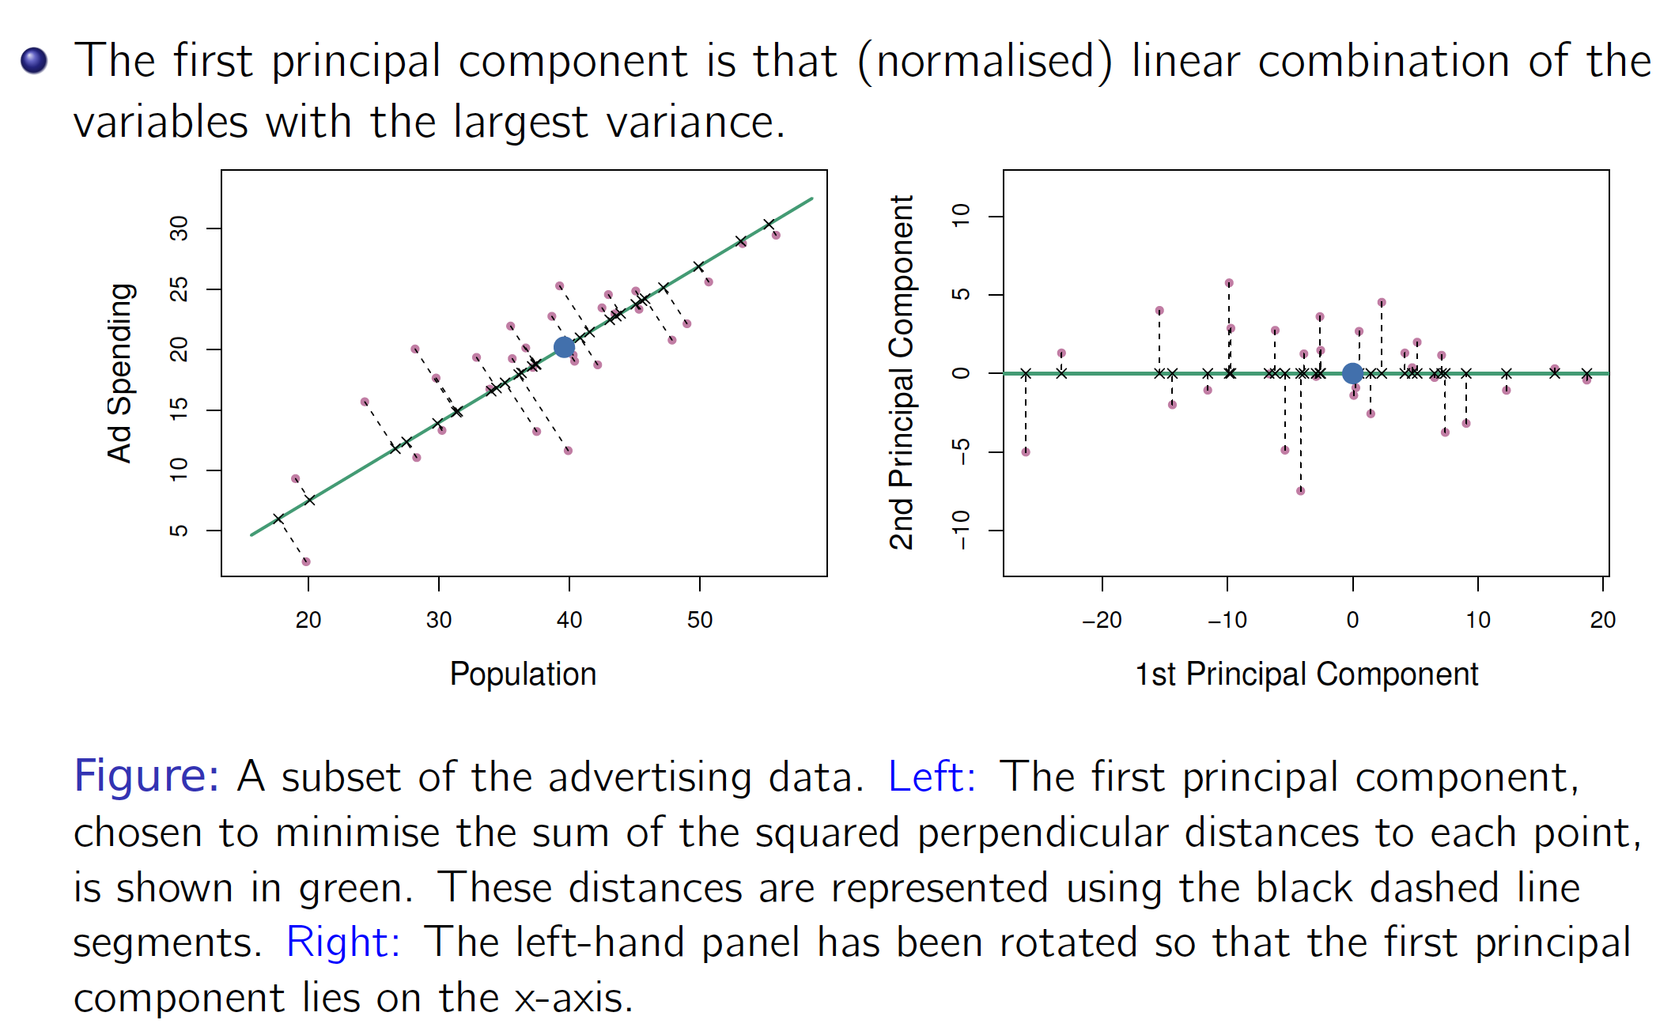
PCA: Visualise First Principle Component
1st

Slide 38
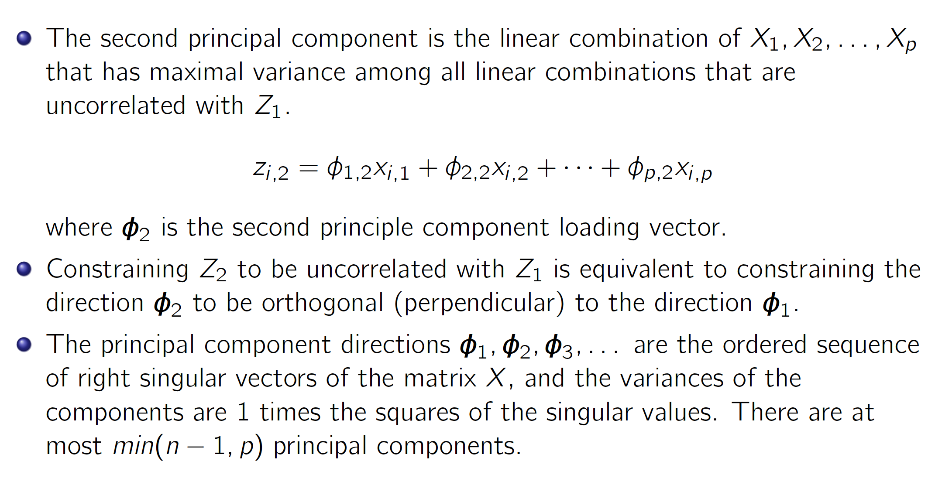
PCA: Visualise Second Principle Component

Slide 39
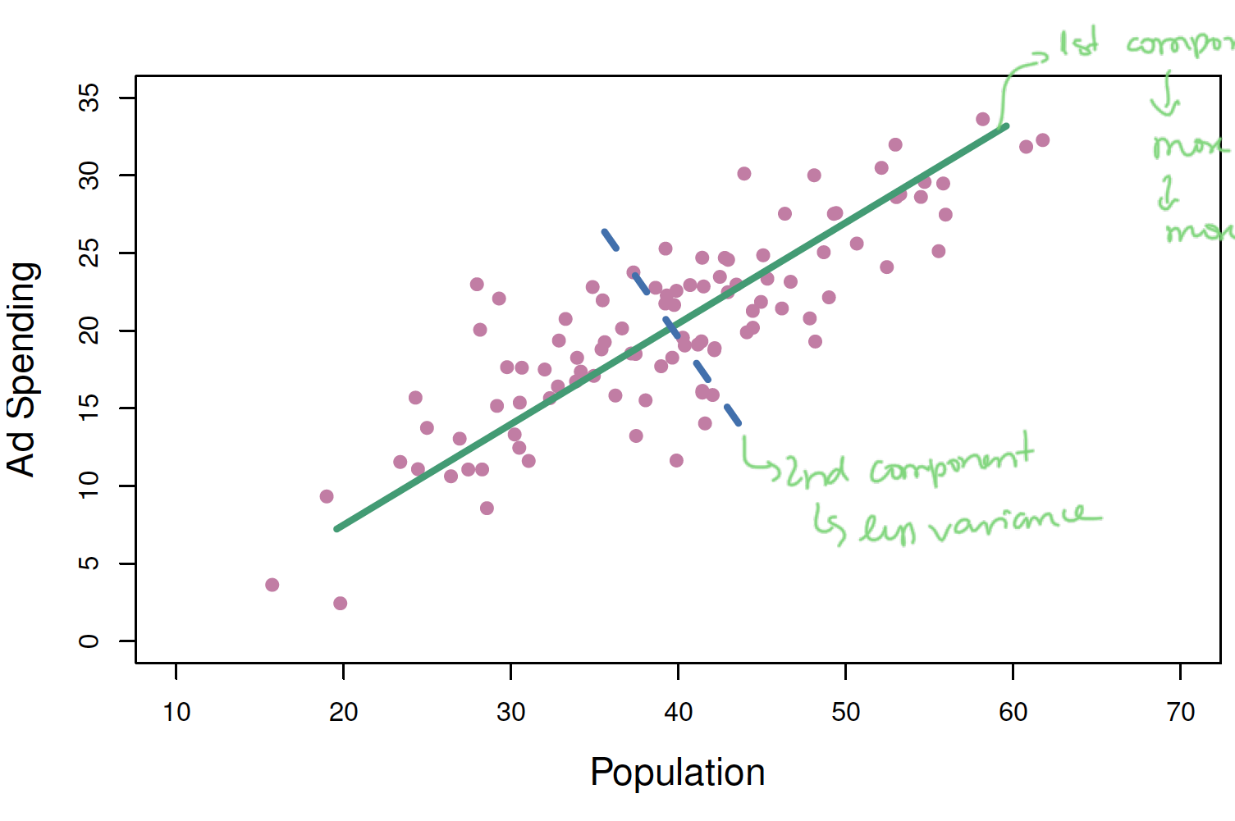
PCA: Visualise Second Principle Component
1st component
2nd component (less variance)

Slide 40
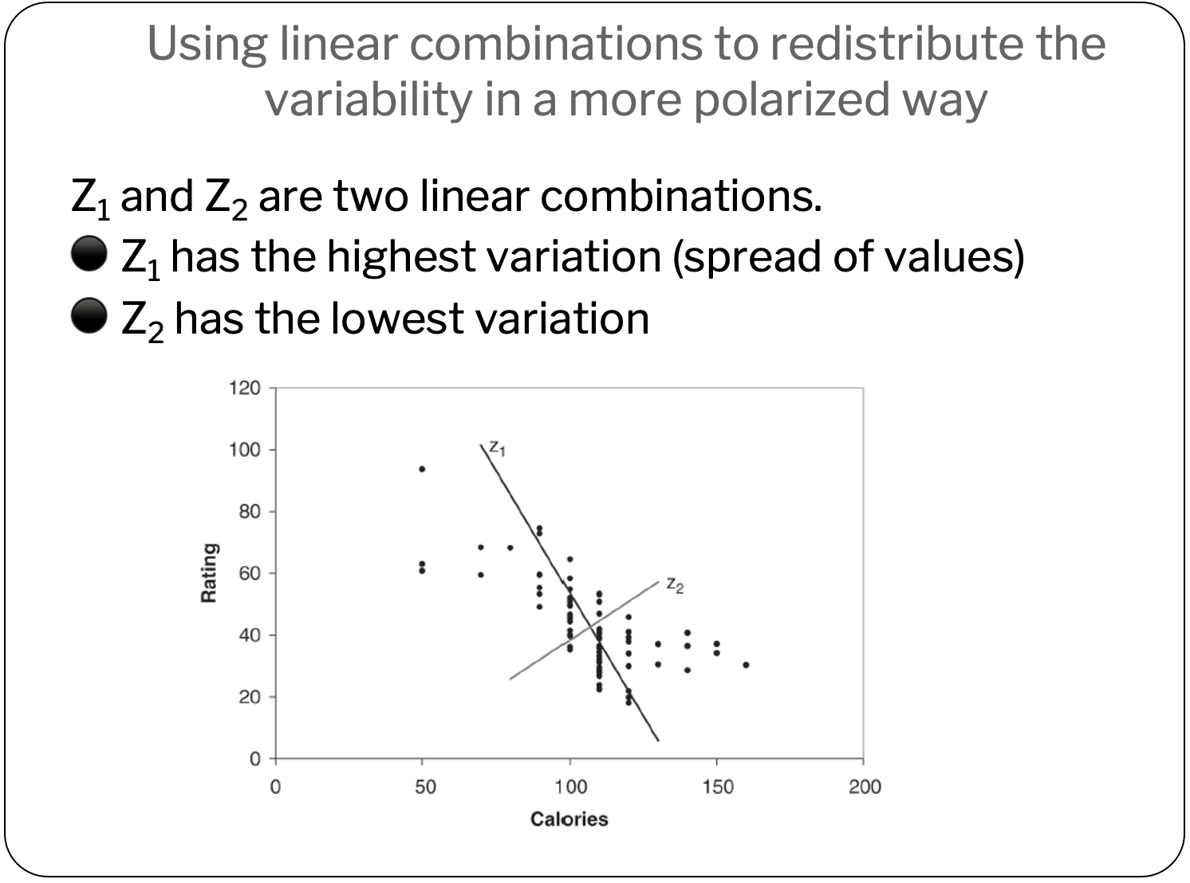
Summary:

Slide 41
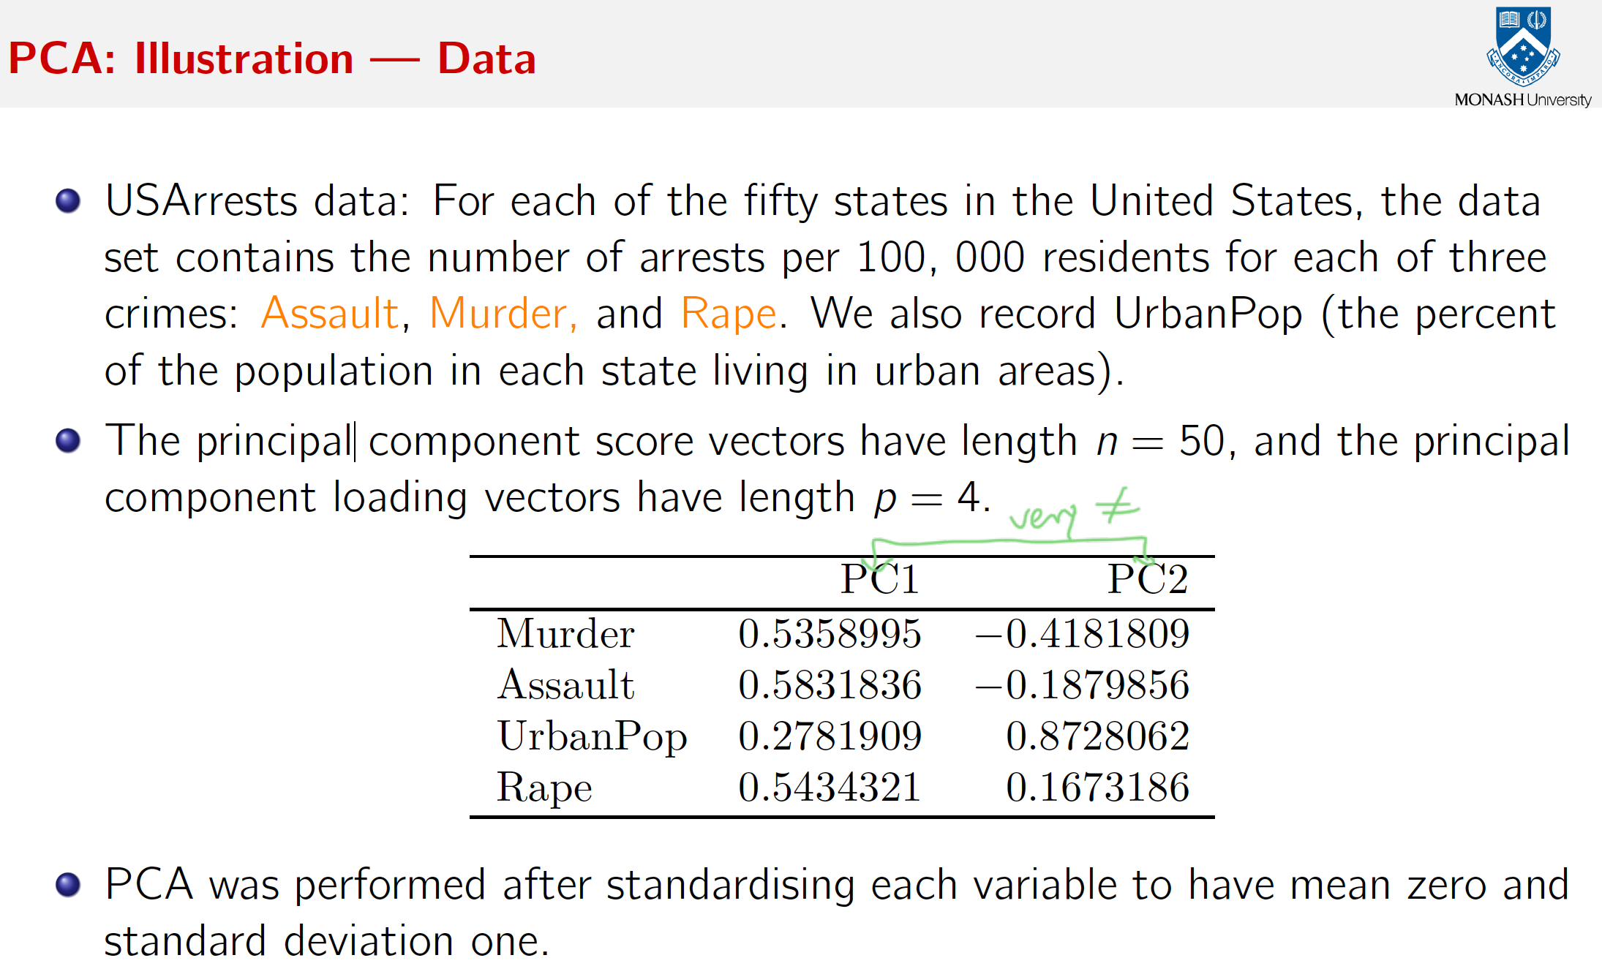
PCA: Illustration data

Slide 42
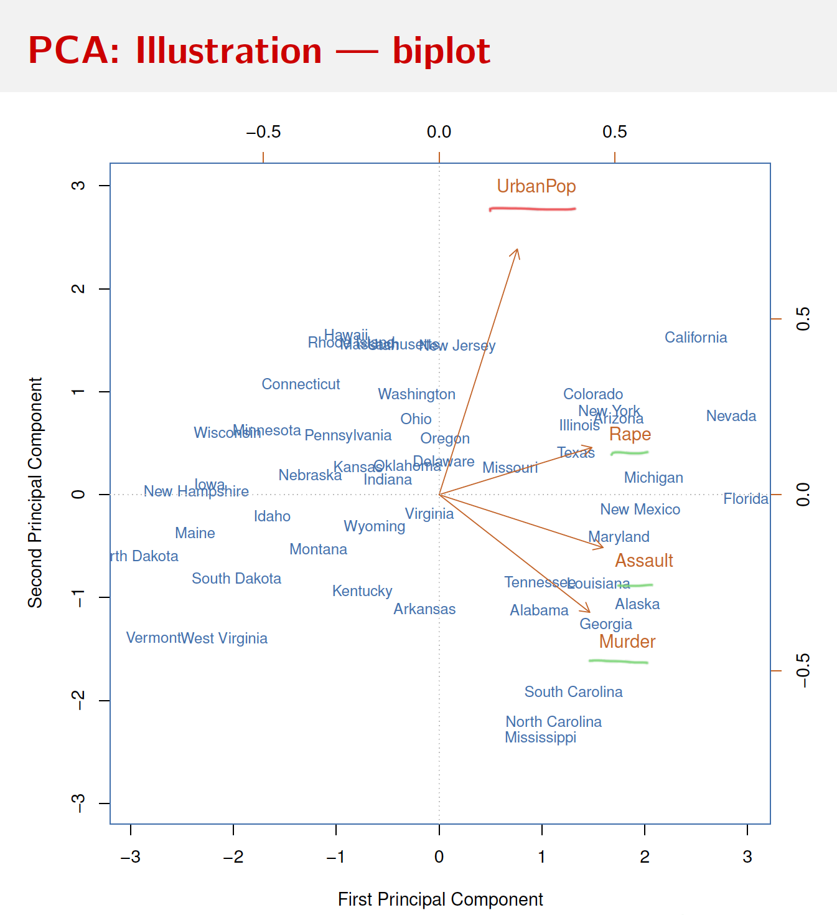
PCA

Slide 43
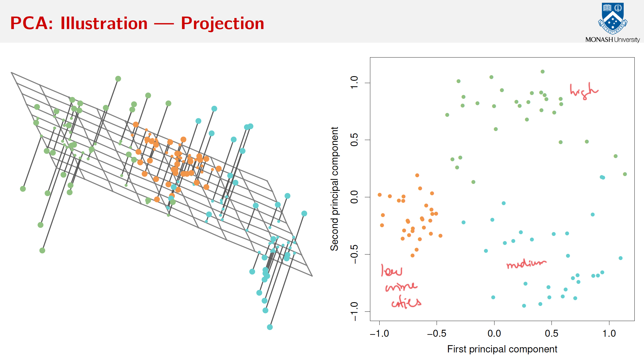

Slide 44
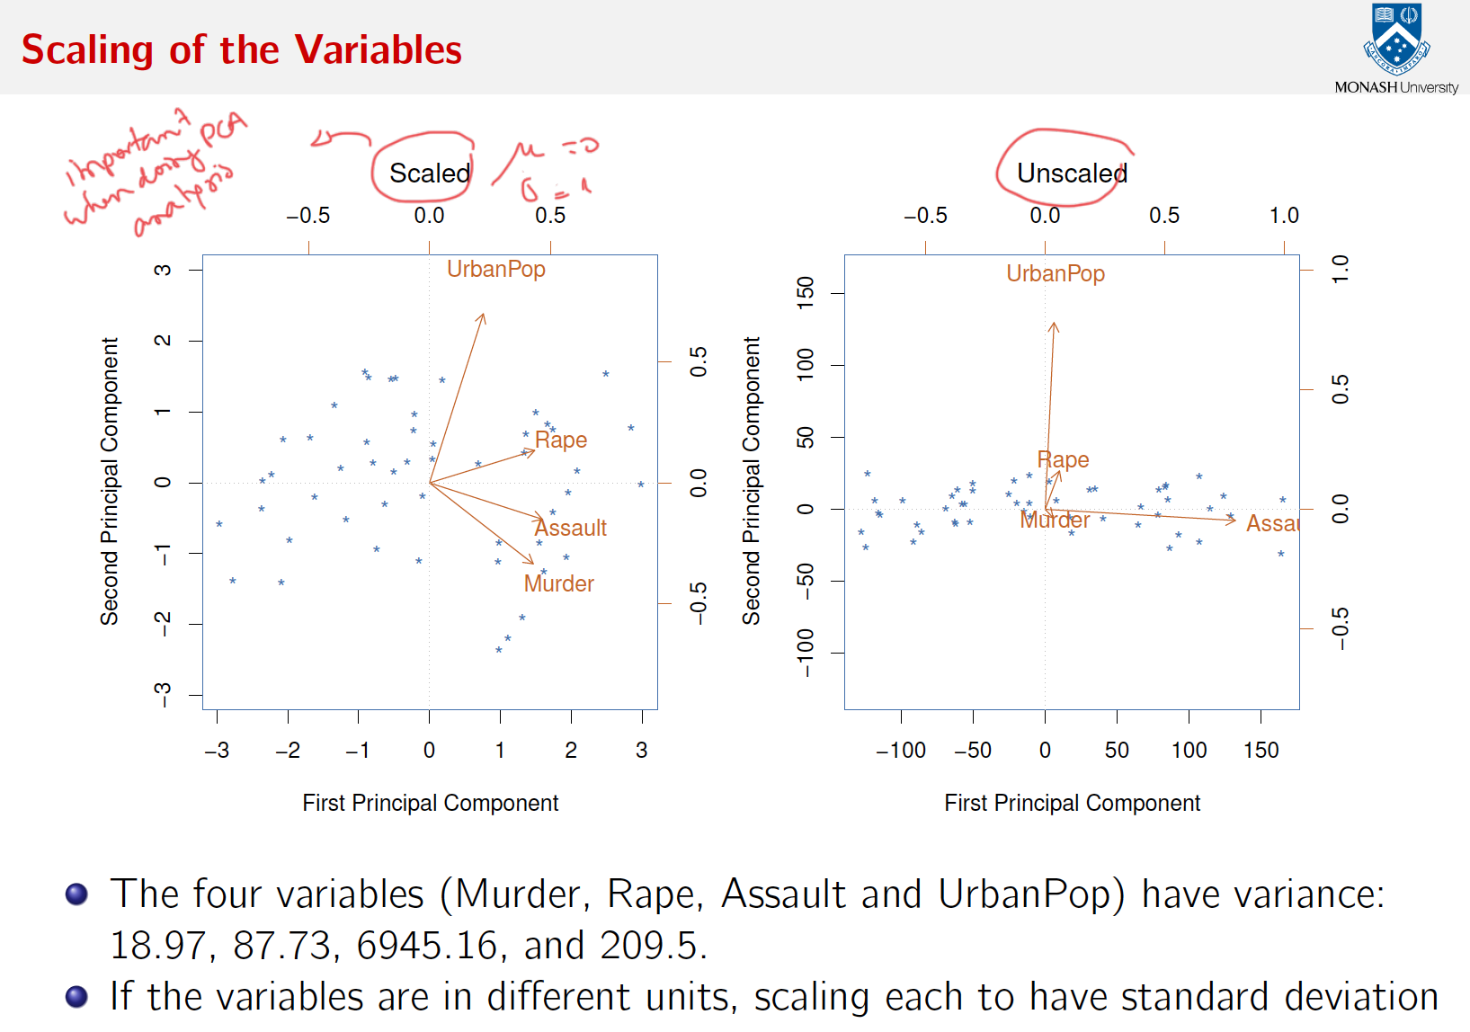

Slide 45
Summary
Principal components : analysis which transforms an original set of numerical data into a smaller set of weighted averages of the original data that contain most of the original information in less variables.

Slide 46
Let’s practice!

Slide 47
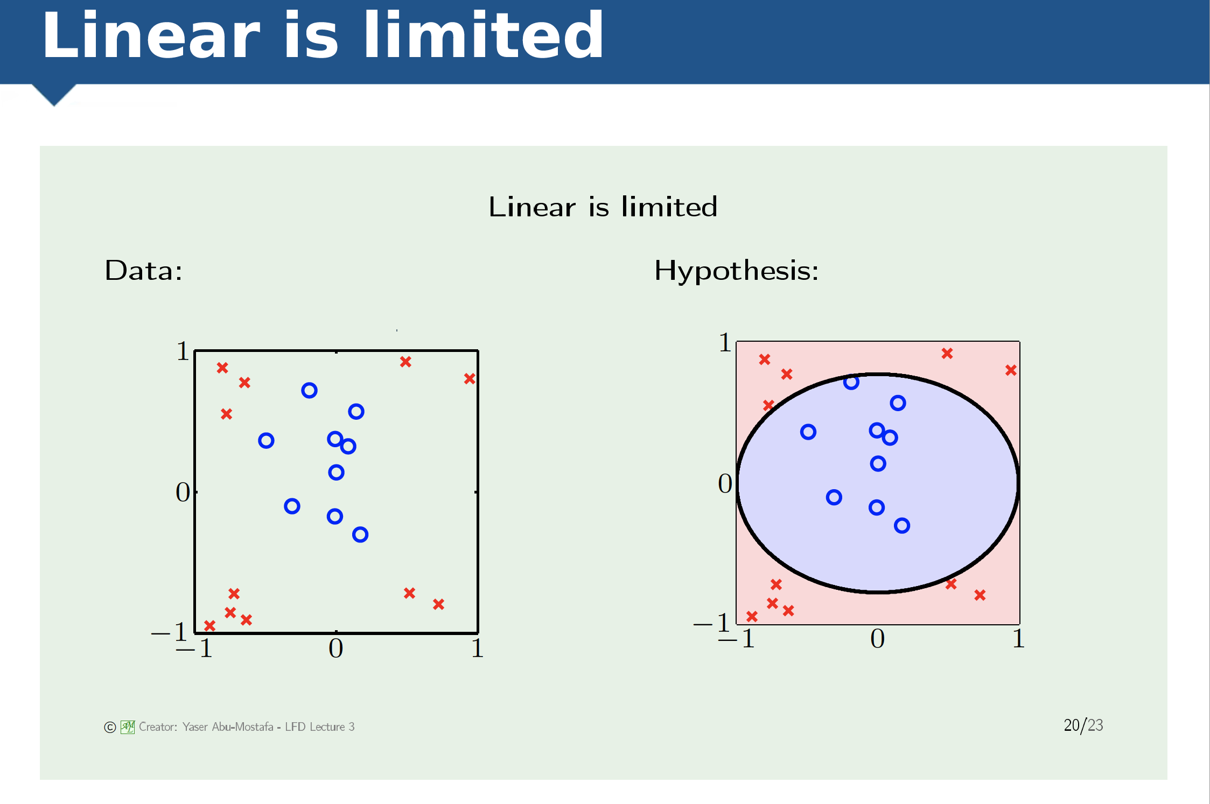

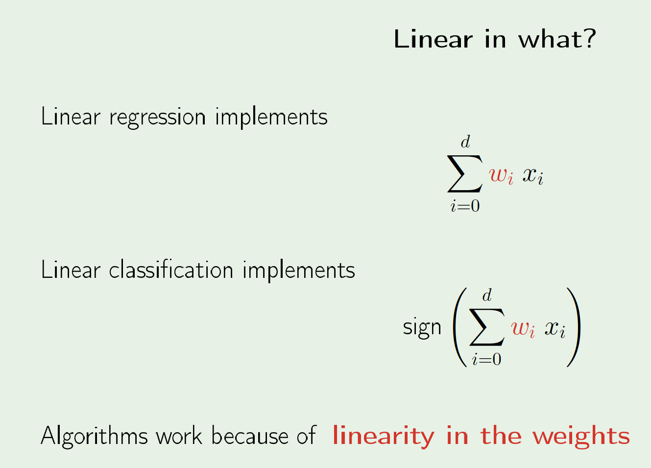
From linear to non-linear

Slide 48
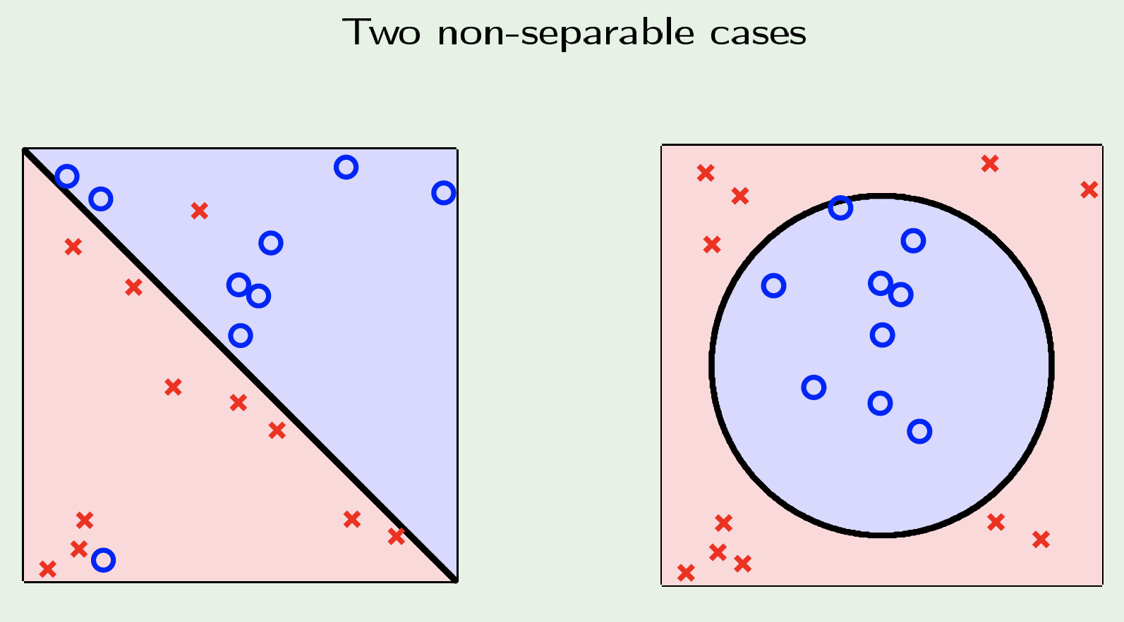
Two cases

Slide 49
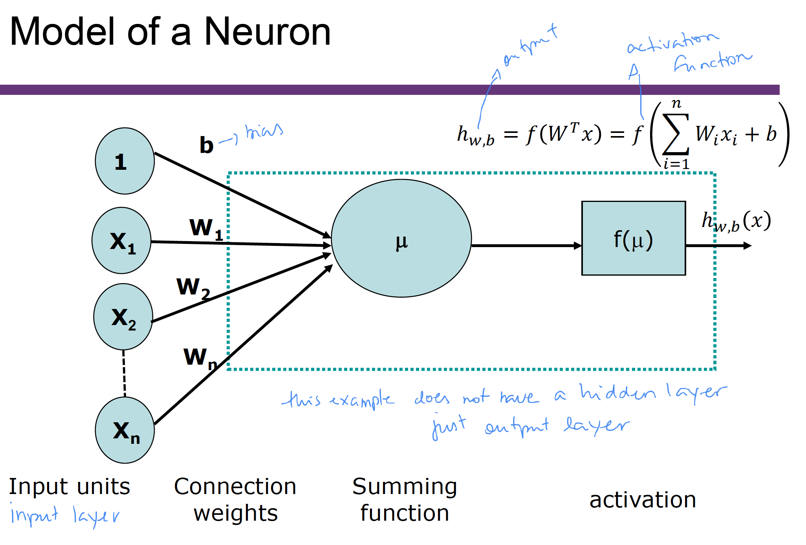

Slide 50
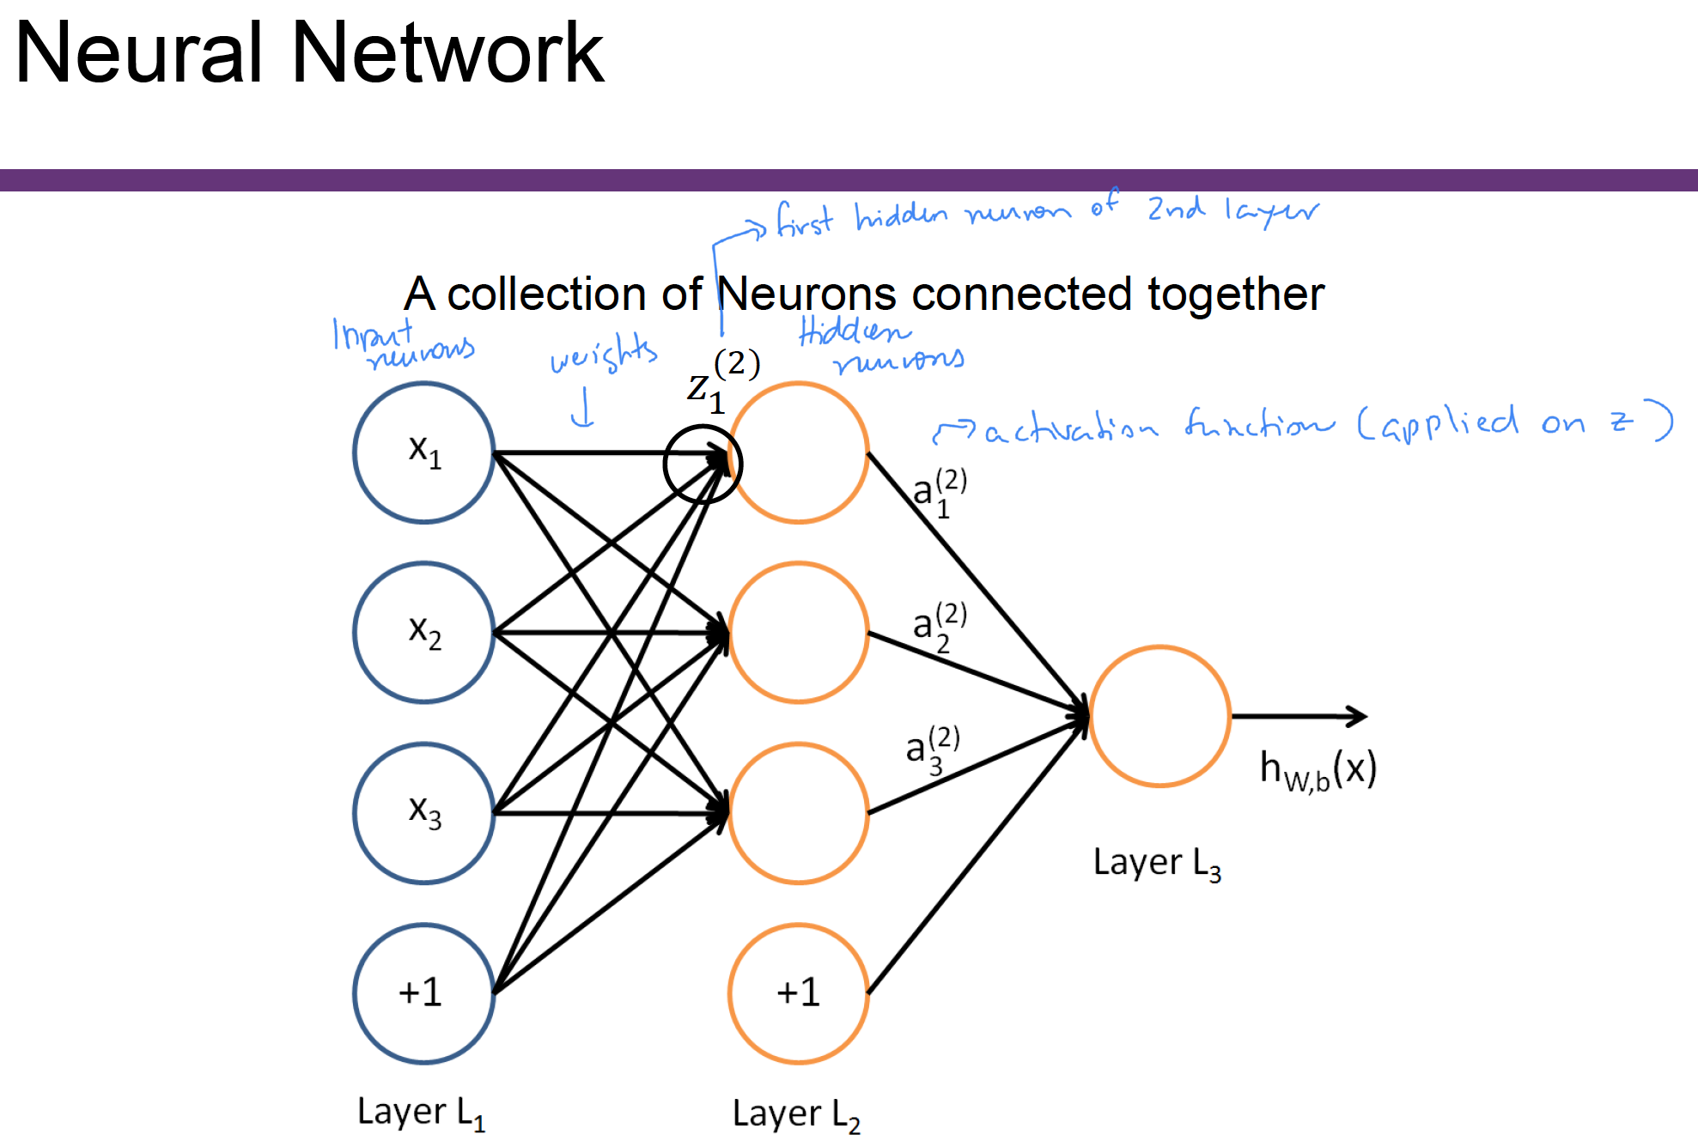

Slide 51
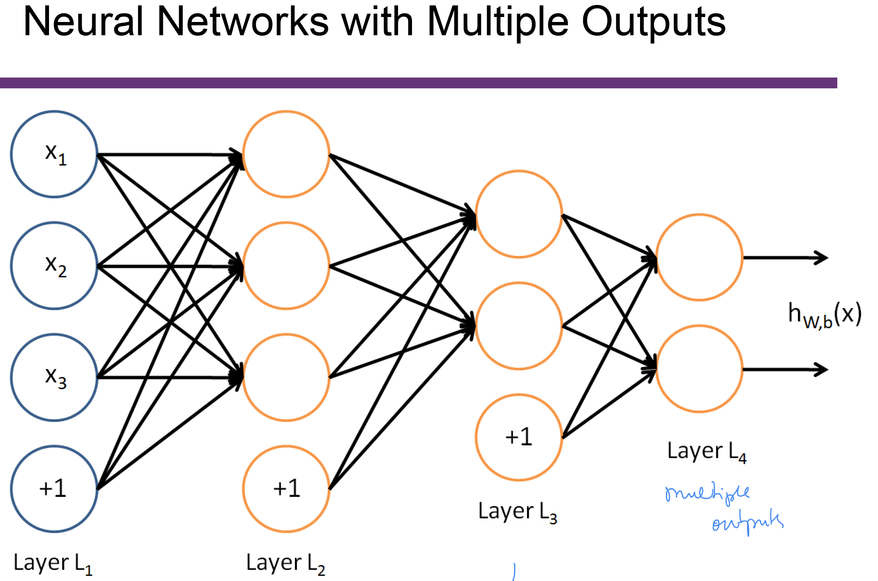

Slide 52
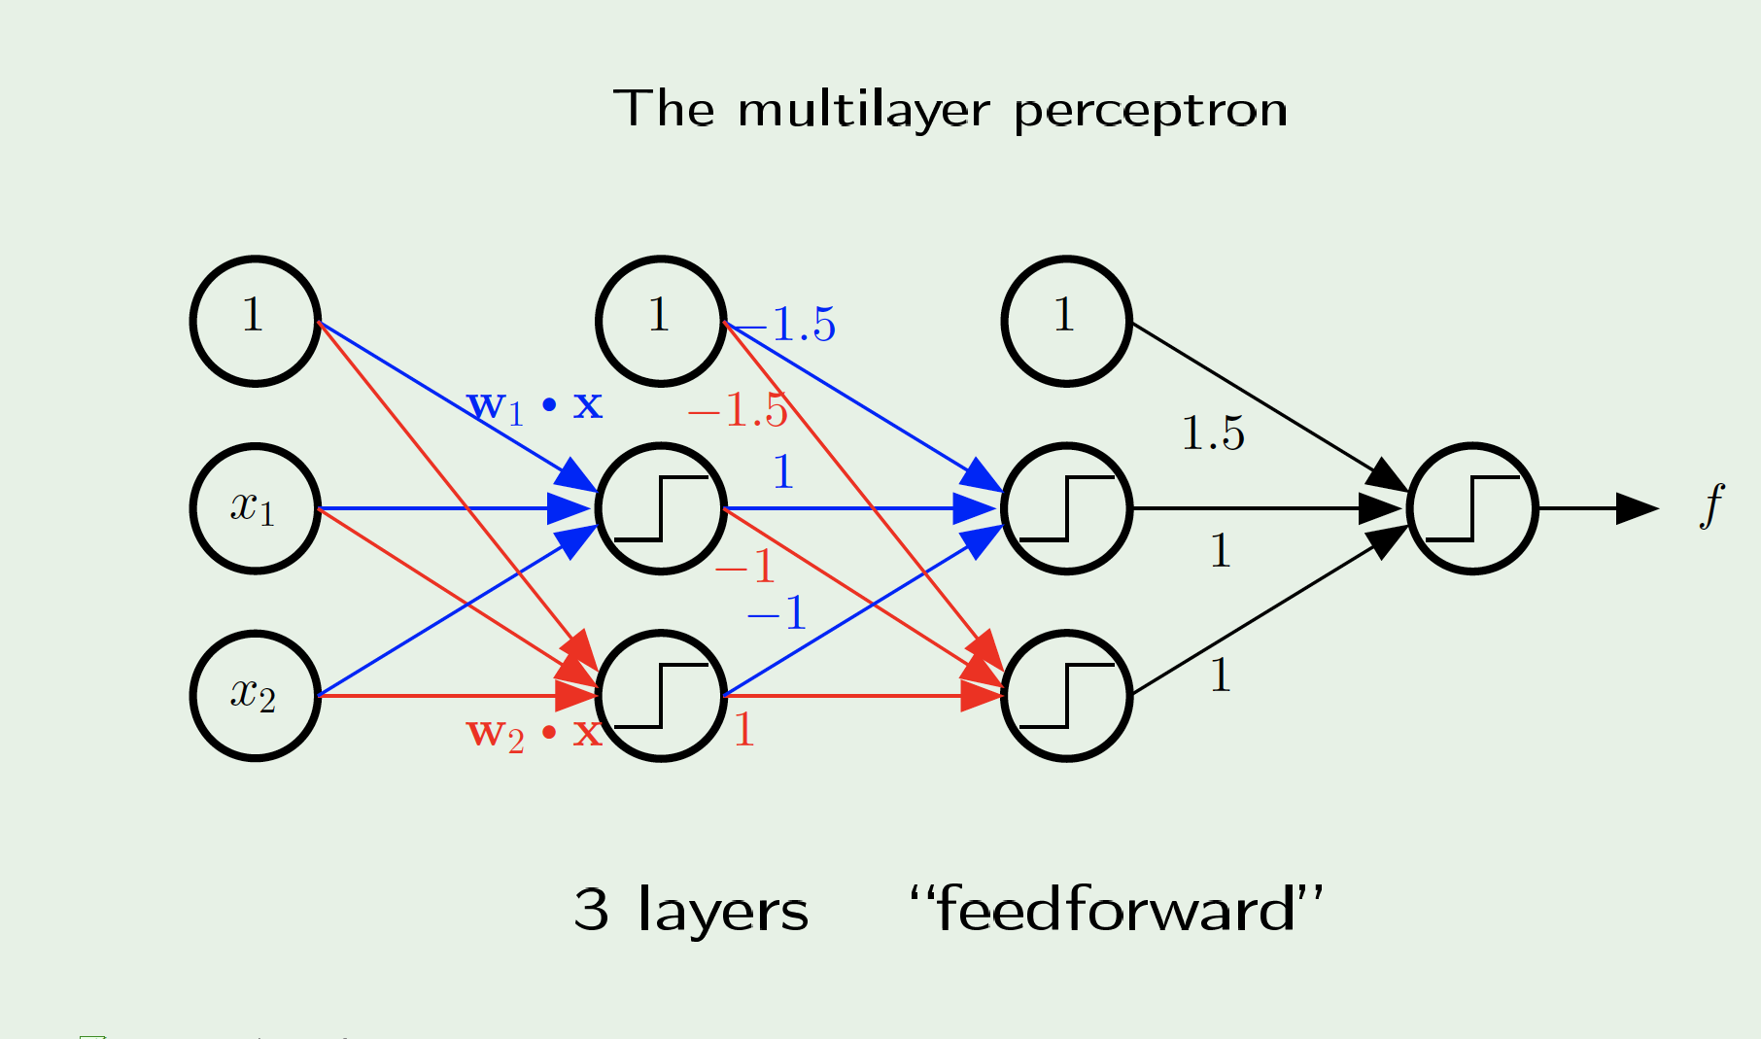
The multilayer perceptron (MLP)
Notes:
52

Slide 53
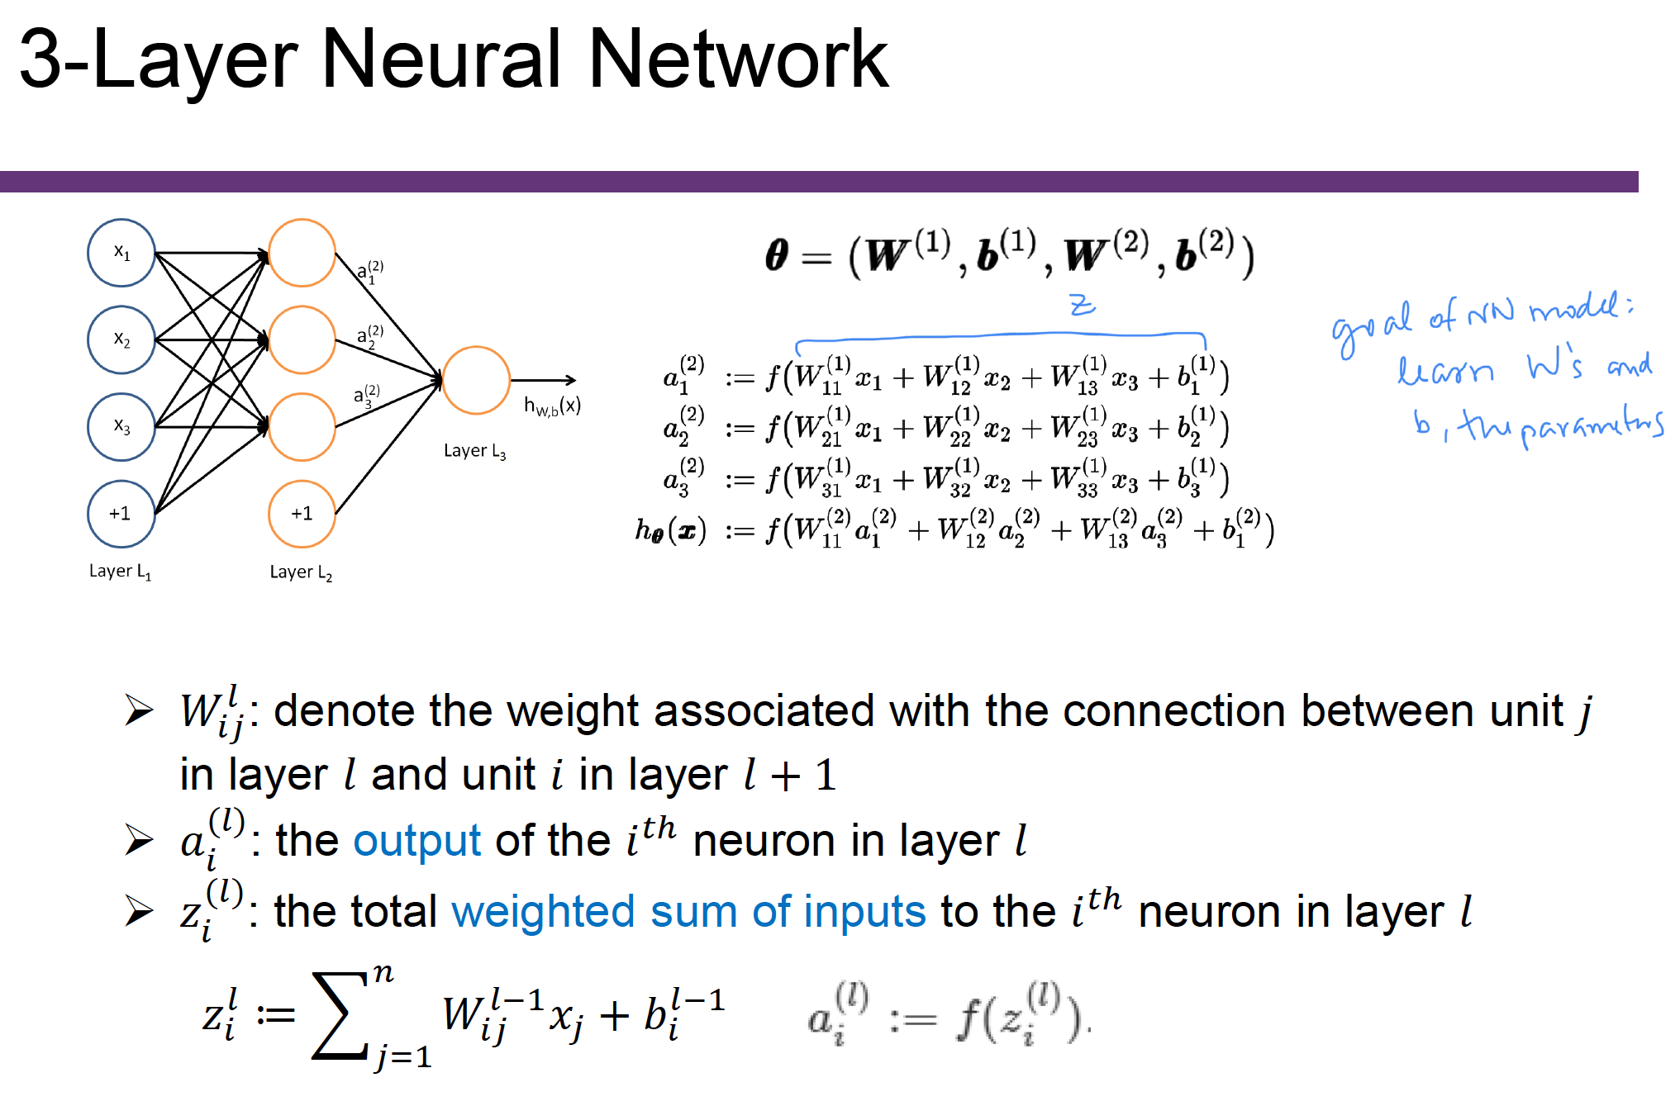

Slide 54
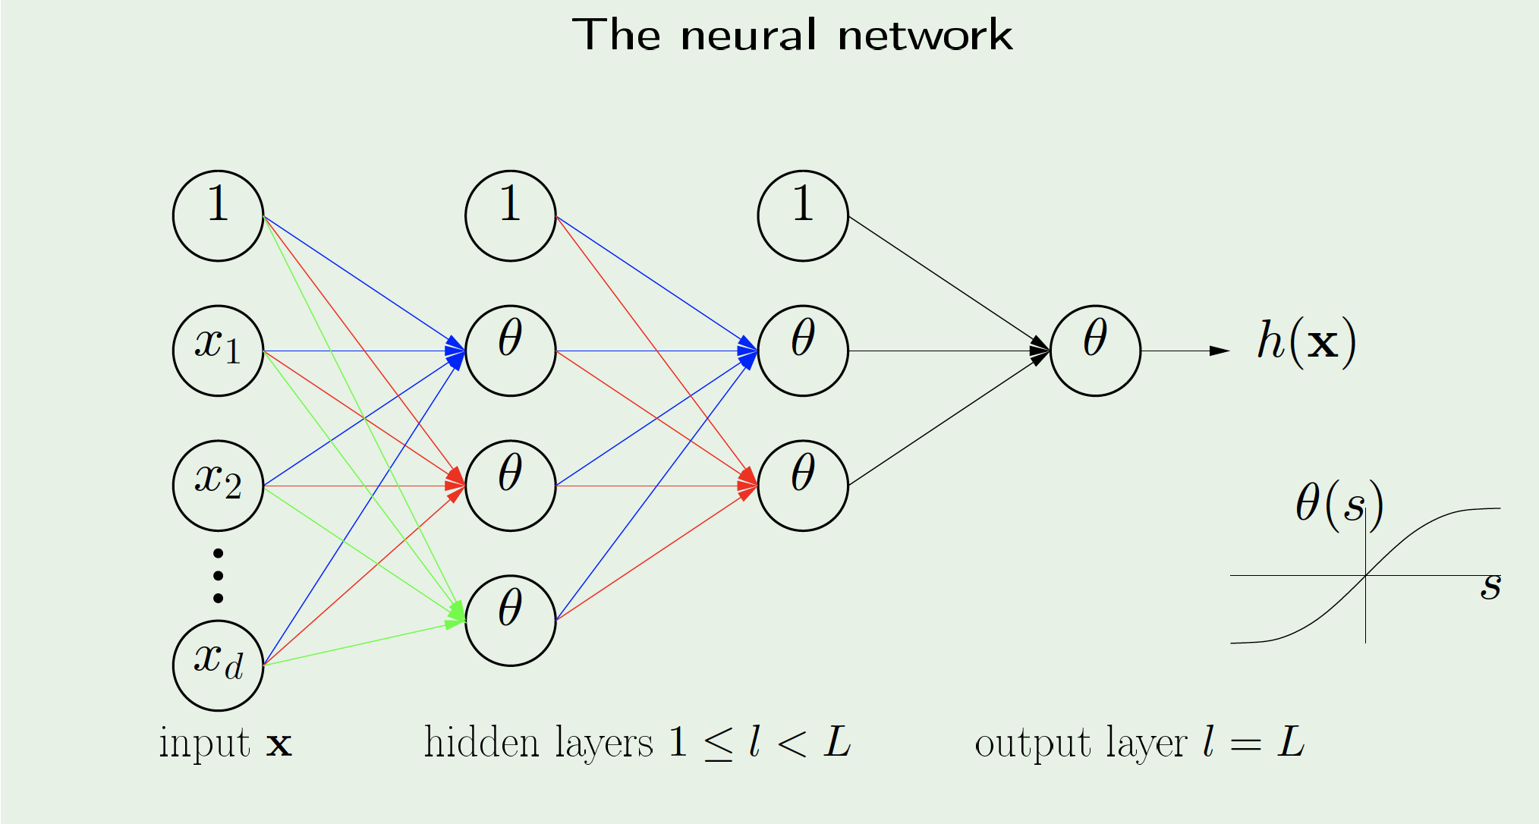
The neural network
Notes:
54

Slide 55
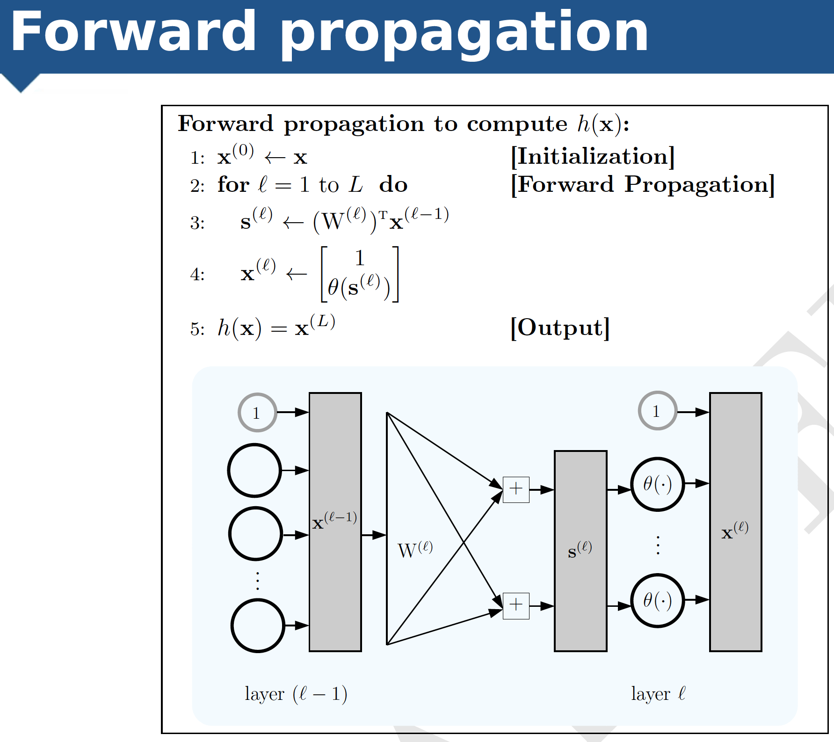

Slide 56
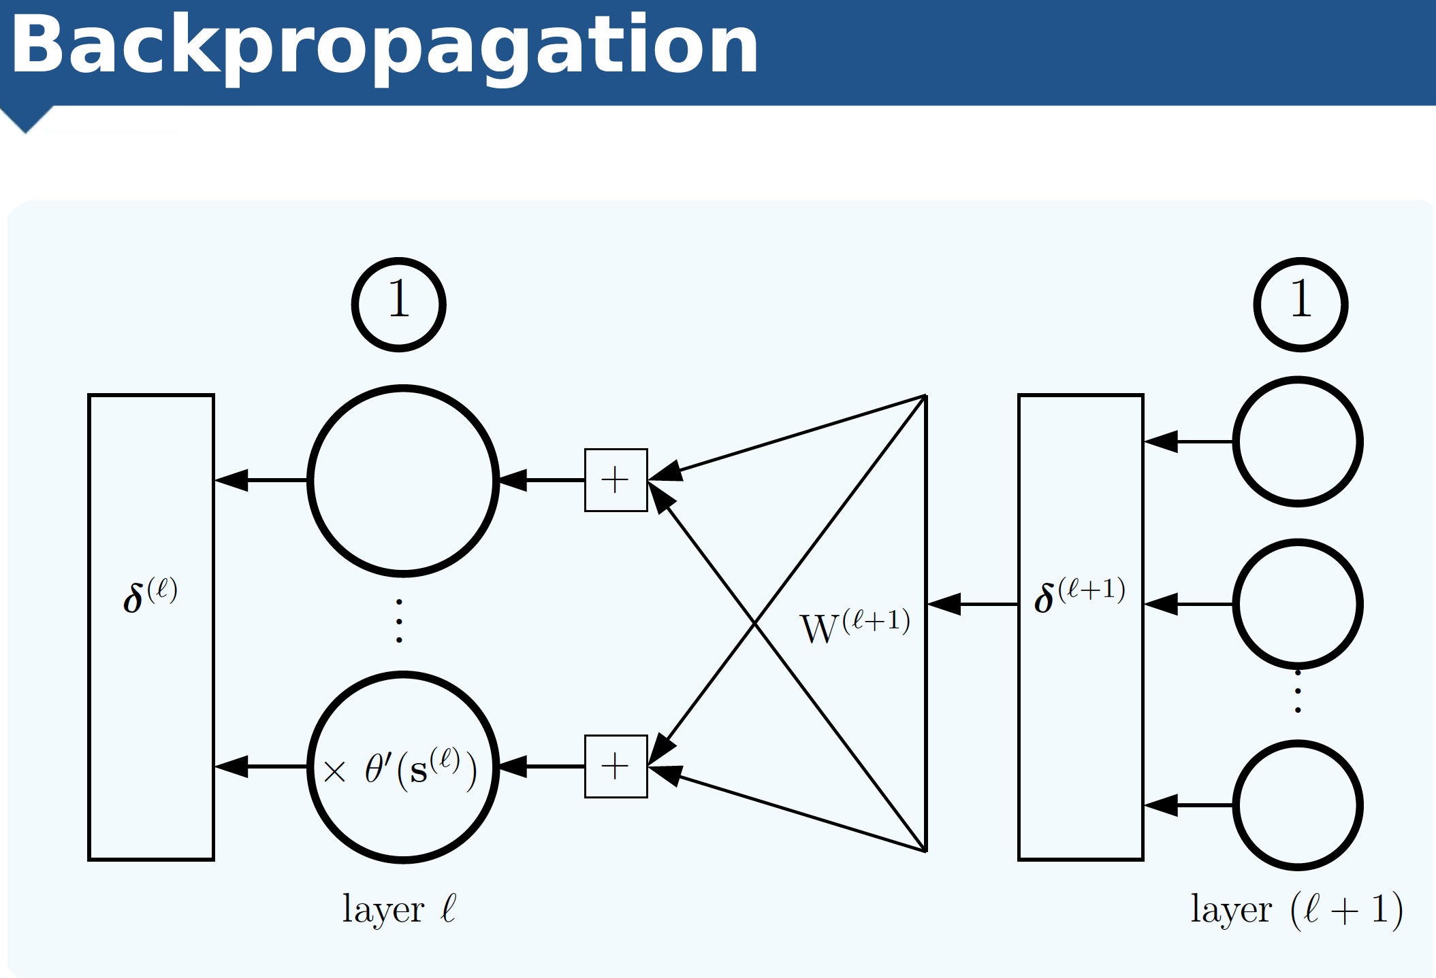

Slide 57
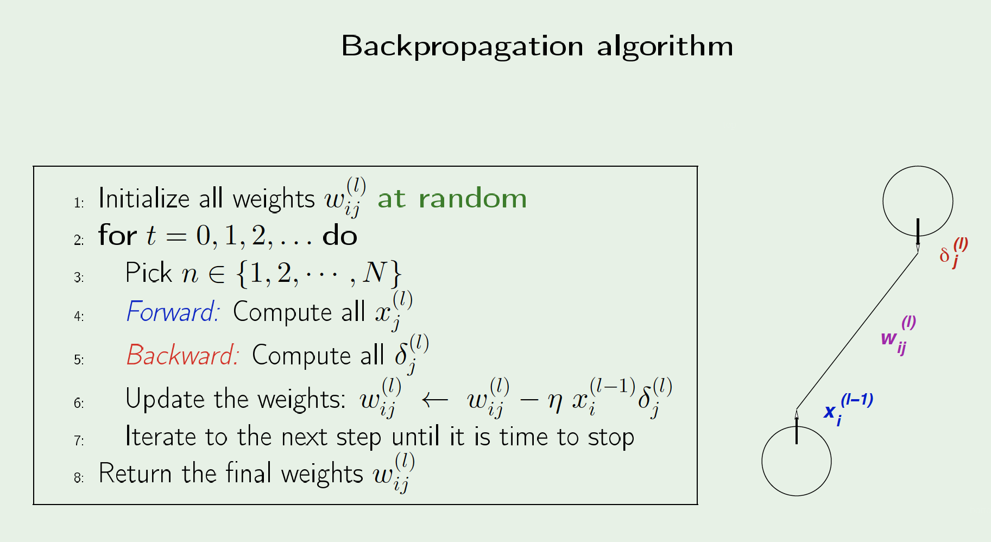
Back propagation algorithm
Notes:
57

Slide 58
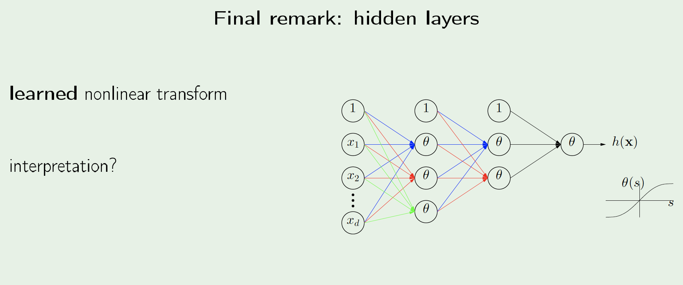
Automatic Feature Extraction
Notes:
58

Slide 59
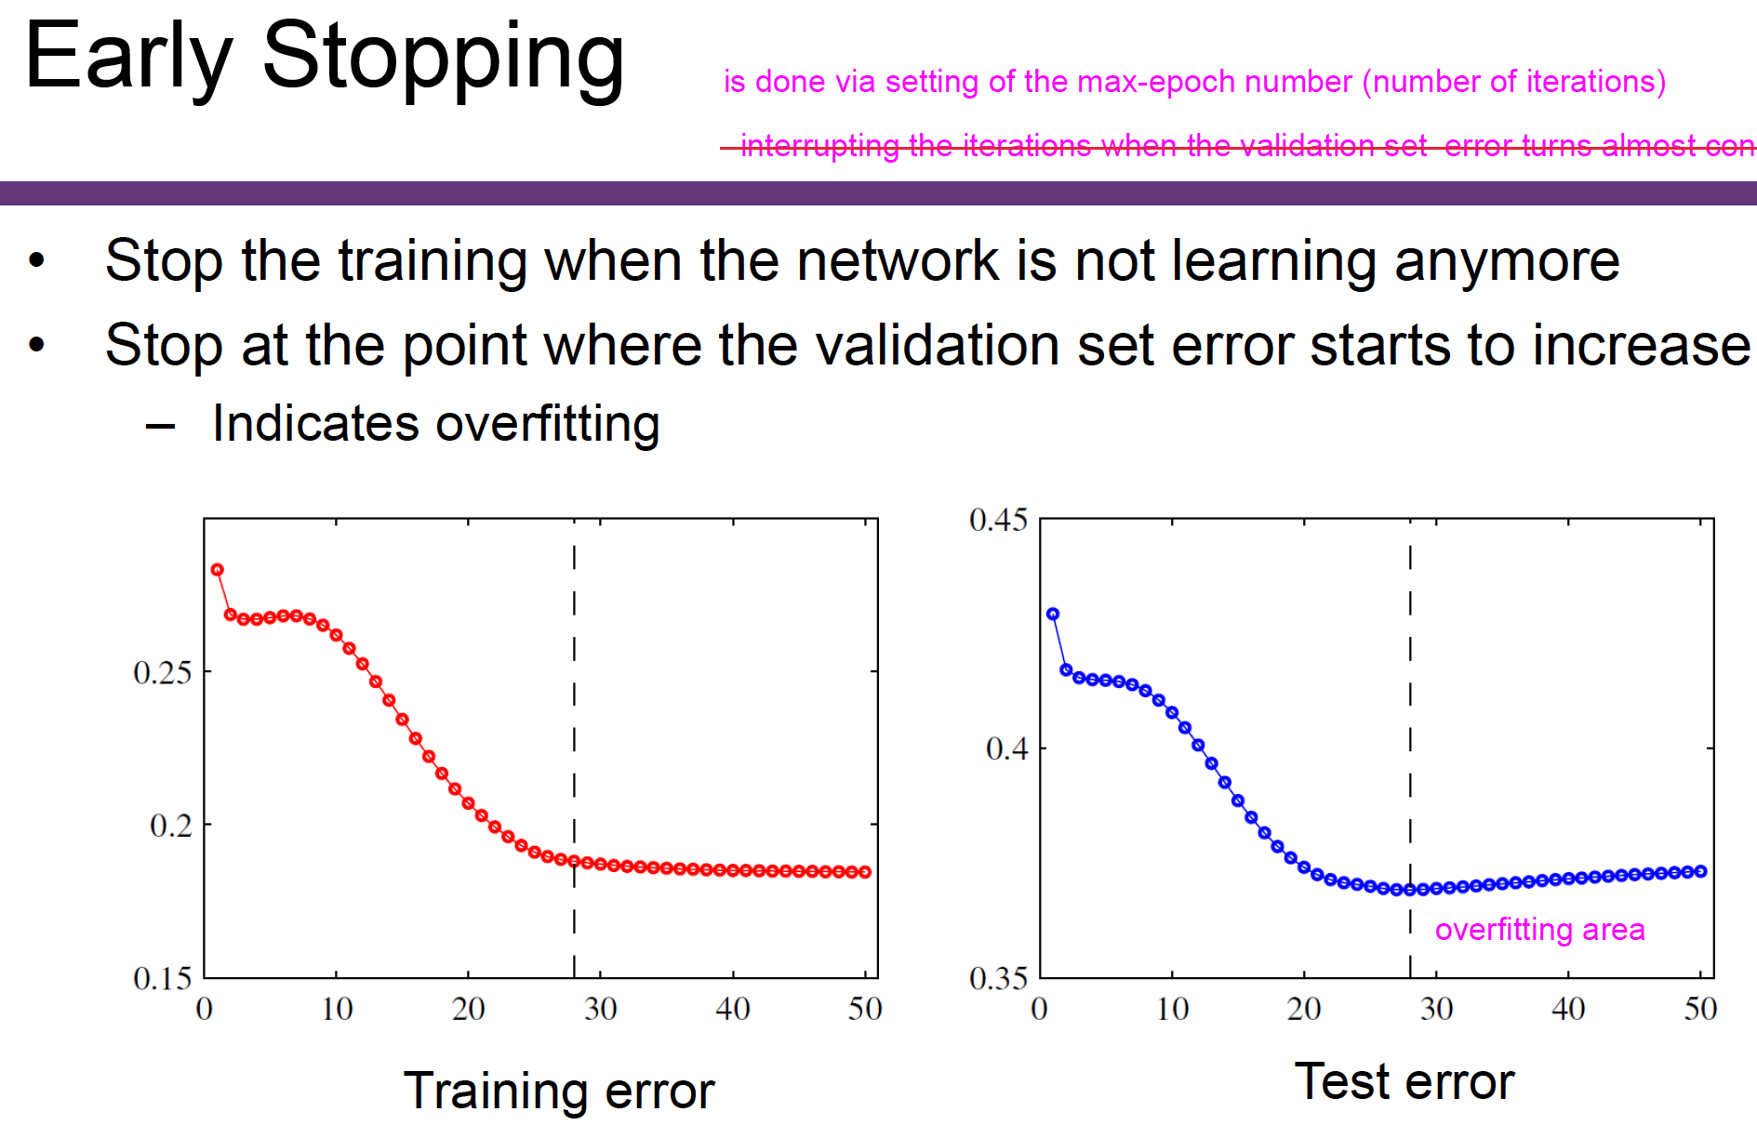
Notes:
59

Slide 60
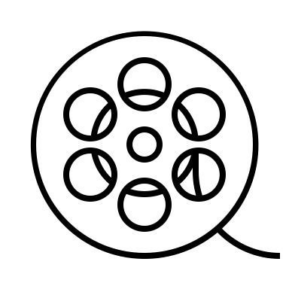

Demonstration

Slide 61
Summary of Day 1
Linear regression models are very popular tools, not only for explanatory modeling, but also for prediction
A good predictive model has high predictive accuracy (to a useful practical level)
Predictive models are fit to training data, and predictive accuracy is evaluated on a separate validation data set
Removing redundant predictors is key to achieving predictive accuracy and robustness
Subset selection methods help find “good” candidate models. These should then be run and assessed.
We run through the main elements and key concepts of ML and the different kind of algorithms for each type of problem and data.

Slide 62
Thank you very much!!!

